Slide 1
Unit 4: Product Review

Slide 2
Objectives
At the end of this unit, students will be able to:
-Give a review of a software or products as a tester and a customer

Slide 3

Activity 1: Board race
Objectives
Upon completion of this activity, students will be able to give a review of software or products as a tester and a customer

Slide 4
Instructions:
Step 02:
Complete the
sentences
Step 1:
Work individually

Slide 5
Apple claims that the iPhone 11 lasts an hour more than the iPhone XR, which already had g_ _ _ _ battery life.
Image quality results are d_ _ _ _ _, but like most of the other devices, they’re far off the quality of shots from the main camera.
Capturing more from a scene is a f_ _ _ _ _ _ on iPhone 11 which you won’t find on Google’s Pixel 4.
The iPhone’s Color score is close to the best, thanks to pleasant color rendering, v_ _ _ _ _ _ saturation, and accurate white balance in all light conditions.
Despite not having ‘Pro’ in its name, you get the same p_ _ _ _ _ _ _ _ _ _ on the iPhone 11 as the iphone 11 Pro, because the entire range is equipped with Apple’s A13 Bionic chipset.
The Samsung Galaxy Note 9 was a little bigger, slightly more colorful, a bit more p_ _ _ _ _ _ _ and pricier than prior Note phones.
The new Air is a lot like the new MacBook Pro models, with a s_ _ _ _ 13-inch Retina display, a responsive trackpad, an improved butterfly keyboard.
The butterfly keys have been optimized for a more r_ _ _ _ _ _ _ _ _ feel, delivering a greater sense of keyboard travel for a more satisfying press under the fingers.
great
decent
feature
vibrant
performance
powerful
sharp
responsive

Slide 6

Activity 2: Typhoon
Objectives
Upon completion of this activity, students will be able to make sentences with the vocabulary and grammar learnt online.

Slide 7
Instructions:
- Work in groups of 8 and in turn, make sentences with the words and grammar provided in slide
- If the answer is correct, the group can choose a number on the grid on slide to have points.
- The group with more points will be the winner.
Note: On the grid:
T: Typhoon (choose another group to blow away their scores)
D: double points
SWAP: swap score with another’s team
S: steal, the group can steal scores from another’s team

Slide 8
1
2
3
4
T
20 points
SWAP
1. Samsung Galaxy S9 7.5mm – Apple Iphone X 8.5mm (thick)
10 points
The Apple Iphone X is 1 mm thicker than the Samsung Galaxy S9.
5
6
7
8
S
SWAP
30 points
40 points
2. Samsung Galaxy S9 – expandable memory up to 400GB (which)
Samsung Galaxy S9 has expandable memory which
is up to 400GB.
9
10
11
12
50 points
S
10 points
20 points
3. Iphone X – Samsung Galaxy S9 (more expensive)
Iphone X is more expensive than Samsung Galaxy S9.
13
14
15
16
T
10 points
40 points
D
4. Storage capacity - Samsung Galaxy S11 (256GB) – Sony Xperia (128GB)
Samsung Galaxy S11 has more storage capacity than
that of Sony Xperia 1.
17
18
19
T
20
50 points
S
D

Slide 9
1
2
3
4
5. The Lenovo Yoga: 3.02pounds – the MacBook Pro: 3.02 pounds (same)
10 points
T
20 points
SWAP
The Lenovo Yoga has the same weight as the MacBook Pro.
5
6
7
8
S
SWAP
40 points
30 points
6. The MacBook 13 – the Samsung Q320 (more expensive)
The MacBook 13 is more expensive than the Samsung Q320.
9
10
11
12
50 points
S
10 points
20 points
7. The Lenovo Miix 510’s processor-The Surface Pro’s processor. (not powerful, as … as)
The Lenovo Miix 510’s processor is not as powerful as The Surface Pro’s processor.
13
14
15
16
T
10 points
40 points
D
8. The Microsoft Surface Pro has more storage than the Samsung Galaxy Book. (bigger)
17
18
19
T
20
50 points
S
D
The Microsoft Surface Pro’s storage is bigger than
the Samsung Galaxy Book’s storage.

Slide 10
1
2
3
4
9. I like the Toughbook. It has sharp touchscreen, lots of room to work and smooth text. (that)
10 points
T
20 points
SWAP
I like the Toughbook that has sharp touchscreen, lots of room to work and smooth text.
5
6
7
8
S
SWAP
40 points
30 points
10. The iPhone 8 Plus/ a glass back/ rather/ smooth metal. (Unlike its predecessors,…)
Unlike its predecessors, the iPhone 8 Plus has a glass back rather than smooth metal.
9
10
11
12
50 points
S
10 points
20 points
11. The Surface Book 2 – the MacBook Pro – 4.02 pounds. (similar)
The Surface Book 2 is similar to the MacBook Pro at 4.02 pounds.
13
14
15
16
T
10 points
40 points
D
12. The True Tone, Wide Color display – the Ipad Pro – the iPad Air 2’s screen (different)
17
18
19
T
20
50 points
S
D
The True Tone and Wide Color display of the Ipad
Pro is different from the iPad Air 2’s screen.

Slide 11

Activity 3: Role-play
Objectives
Upon completion of this activity, students will be able to make a conversation to ask and give opinions and recommendation on a new IT product.

Slide 12
Instructions:
- Work in pairs
+ Student A: a testing team leader
+ Student B: a product tester
- Make a conversation to ask and give opinions and recommendation on a new IT product that is going to be launched next year based on the given information in the card below
- Practice the conversation in front of class

Slide 13
STUDENT A: LEADER | STUDENT B: TESTER
1. Greeting. Say the purpose of the meeting (collect opinions/ review of this product, then improve its quality), and ask the tester to give the product review | 2. Greeting. Say you are glad to give your review on the product.
3. Ask for his/her opinions on its features (design, color, size, shape, durability, image quality, battery life, etc.) | 4. Respond to the questions
5. Ask about the pros and cons over other devices | 6. Make comparison with other devices which has the same price
7. Ask about recommendation | 8. Give some recommendations
9. Say thanks

Slide 14
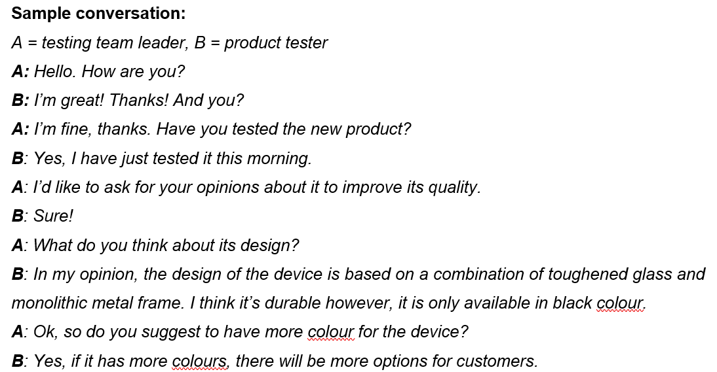

Slide 15
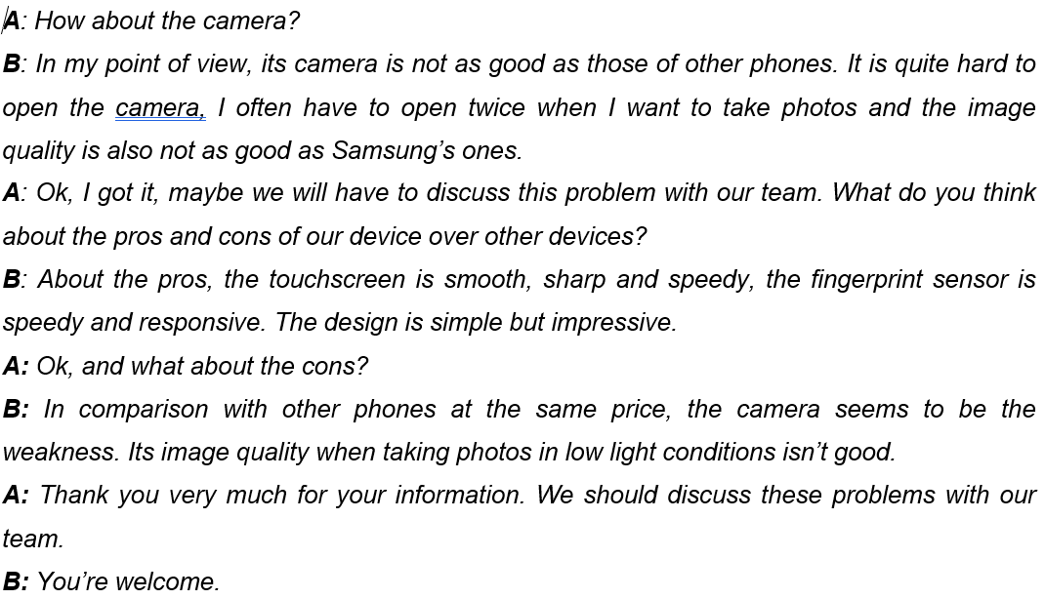

Slide 16

Activity 4: Interview customers
Objectives
Upon completion of this activity, students will be able to make a conversation to ask and give opinions and recommendation on a new IT product.

Slide 17
Instructions:
- Your company has a new IT product, interview at least other 3 customers to get their opinions and recommendation about it and complete the note below (use expressions of asking and giving opinions and recommendation learnt online).
- Then report to the class

Slide 18
NO | QUESTIONS | CUSTOMER 1 | CUSTOMER 2 | CUSTOMER 3
1 | Name/ Type of product
2 | Features (design, color, size, shape, durability, image quality, battery life, stereo sound, Internet speed capability, ….)
3 | Performance (memory, processor, …)
4 | Pros and cons
5 | Recommendation to improve the product

Slide 19

Activity 5:Review a product
Objectives
Upon completion of this activity, students will be able to give a review on a new IT product.

Slide 20
Suggested questions:
1. What is the name of the product?
2. What do you think of its features and functions (design, color, size, shape, durability, image quality, battery life, stereo sound, ….)?
3. What is your opinion on its performance (memory, processor, …)?
4. What are its pros and cons?
5. What is your recommendation to improve this product?

Slide 21
Structures:
- Compared to + Noun, S + V = In comparison with + Noun, S + v: so sánh với …,
Ex: Compared to the previous versions, …;
In comparison with other phones at the same price;…
In terms of = Regarding = In regards to: về
= When it comes to + Noun : khi nói về…
- S + (feature/provide/offer) + Noun…: …có đặc điểm, cung cấp, mang lại …
Allow/enable/permit/help users to + V-inf: cho phép người dùng làm gì = let users + V-inf
Be avaibble in … colors: có sẵn … màu

Slide 22
OUTLINE
Name of IT product: iPhone 12 Pro Max, the biggest, heaviest and most expensive version of Apple’s smartphone for 2020.
Review:
Design: features a new flat-sided design, which looks more industrial and brings a solid feel. However, compared to the previous versions, it is a little less comfortable to hold.
Color: is available in four colors: Graphite, Gold, Silver and Pacific Blue => look luxurious, outstanding and different from other phones
Performance:
is powered by A14 Bionic chip, the fastest chip inside a smartphone for both GPU and CPU performance and can supposedly complete 11 trillion operations per second.
Has 6GB of Ram with the starting storage of 128GB, supports 5G connectivity => allow users to upload and download faster
Battery life: Battery life is close to the iPhone 11, at around 17 hours for video and 65 hours for audio playback.
Advantages: powerful, has the longest battery life, top-notch camera
Disadvantages: feel almost too large, super heavy, the most expensive iPhone ($1,099 for 128GB, $1,199 for 256GB or $1,399 for 512GB of storage)
Recommendation: include earpods and power adapter, reduce the cost => suitable with people from all walks of life.

Slide 23
Review form
Name of the IT product | ………………………………………………………………….
Version | ………………………………………………………………………
Rating (1 – 5 stars) | ………………………………………………………………………
Your review | ……………………………………………………………………… ………………………………………………………………………
Recommendation | ……………………………………………………………………… ………………………………………………………………………

Slide 24
Thank you!

